Slide 1



Student advisory committee
College & Career center overview
October 10, 2022

Slide 2


Team
Book a Meeting https://bit.ly/BCHS-CCC-Meet
Morgan Milavickas MilavickasM@pcsb.org
Heidi Anderson-Rhodes Andersonrhodesh@pcsb.org

Slide 3
Areas of focus
HOW DO I GET THERE?
HOW WILL I PAY FOR IT?
WHAT DO I WANT TO BE?
HOW MUCH WILL IT COST?
Explore Careers
Explore Paths
Program Costs
$$$
Notes:
Explore Careers:
Favorite classes, big futures
Discuss industry hub cities
Explore Careers:
Post HS Options

Slide 4

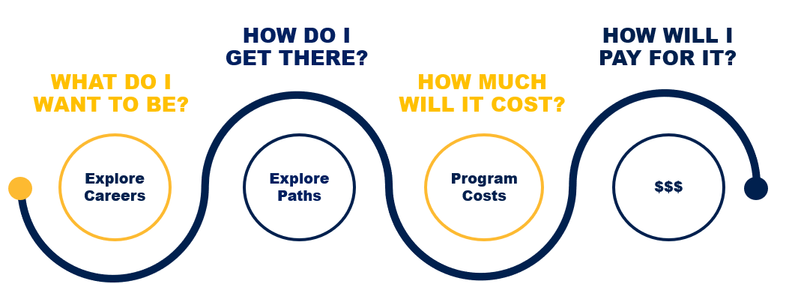

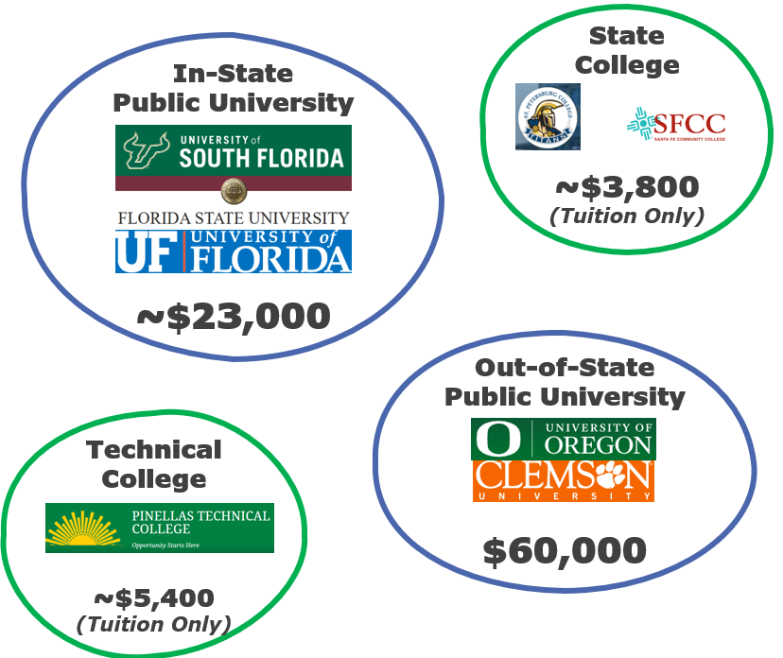
College/University Profiles
Technical College
Military
Gap Year
Straight to Work
Qualifying Criteria
Exam Prep
Money Matters
Tuition
Living Costs
Budgeting
Dual Enrollment
Scholarships
Financial Aid
529 Plans
Naviance Career Cluster
ASVAB
Questionnaires
GATI
Guest Speaker Series
Notes:
Explore Careers:
Favorite classes, big futures
Discuss industry hub cities
Explore Careers:
Post HS Options

Slide 5

Qualifying Criteria
Exam Prep
Naviance Career Cluster
ASVAB
Questionnaires
GATI
Guest Speaker Series
Money Matters
Tuition
Living Costs
Budgeting
Dual Enrollment
Scholarships
Financial Aid
529 Plans
University Profiles
Colleges / Junior Colleges
Technical College
Military
Gap Year
Straight to Work
Notes:
Explore Careers:
Favorite classes, big futures
Discuss industry hub cities
Explore Careers:
Post HS Options

Slide 6
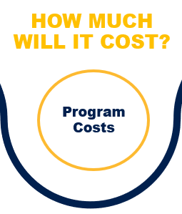
Naviance Career Cluster
ASVAB
Questionnaires
GATI
Guest Speaker Series
College/University Profiles
Technical College
Military
Gap Year
Straight to Work
Qualifying Criteria
Exam Prep
Private vs. Public Institutions
In-state / Out of State
Tuition
Living Costs
Budgeting
Notes:
Explore Careers:
Favorite classes, big futures
Discuss industry hub cities
Explore Careers:
Post HS Options

Slide 7

Naviance Career Cluster
ASVAB
Questionnaires
GATI
Guest Speaker Series
College/University Profiles
Technical College
Military
Gap Year
Straight to Work
Qualifying Criteria
Exam Prep
Money Matters
Tuition
Living Costs
Budgeting
Dual Enrollment
Scholarships
Financial Aid
529 Plans
Employment
Athletics
Local Clubs / Community Foundations
Notes:
Explore Careers:
Favorite classes, big futures
Discuss industry hub cities
Explore Careers:
Post HS Options

Slide 8
Events calendar
August
September
October
November
Class Seminars
Seniors: Transcript Reviews, Post-HS Plans, College Search & Applications
Juniors: College Exploration
Class Seminars
Sophomores: Career Exploration
Freshmen: Class Selection
Common App / SSAR Workshops
Bright Futures
Questbridge
$$ Applications
FAFSA
Florida Financial Aid
Pinellas Education Foundation
College & Military Fair
SPC Application Drive
ASVAB
Great American Teach-In
FAFSA Completion Night
Money Matters

Slide 9


FAFSA
BCHS College and Career Readiness

Slide 10

What is FAFSA?
FREE Application for
Federal Student Aid
Up to $6,895
Pell Grants
Money for Work-Study
Subsidized Loans
A prerequisite for many scholarships
Notes:
Annual Application: Complete for every year you attend post-secondary school
Personal Info, Financial Info, Dependency Status
Used to calculate your Expected Family Contribution (EFC) – an index number that colleges use when determining how much financial aid you’d receive if you attend their school.
The application determines a student’s eligibility to receive: Grants, WS, Loans (subsidized)
Many states and colleges use FAFSA data to award their own aid.
Grants – Do not have to be repaid
Pell Grants
Federal Supplemental Educational Opportunity Grants (FSEOG),
Teacher Education Assistance for College and Higher Education (TEACH) Grants
Iraq and Afghanistan Service Grants.
Work-Study Jobs
Earn money to pay for school by working part-time (at least min wage).
Often in your major – your boss knows you are in school
On or off-campus
Loans
Must be paid back with interest
Understand repayment option

Slide 11

Where can I get help?
November 17, 6-8pm : Boca Ciega Media Center FAFSA Completion Night
(Learn More: PCSB:org/FAFSA)
1-on-1 support
at the:
Step by Step Instructions: https://www.nitrocollege.com/fafsa-application
Notes:
Income: 2021 TAX YEAR
Assets and Family Info : AS OF FILING DATE
If DRAMATICALLY DIFFERENT between 21/22: Fill it out and reach out directly to college to talk about an appeal / judgment
Fill out FAFSA: Create an FSA ID (your signature); One for the student and One for the parent
Review your aid offer: Your aid offer explains the types and amounts of aid a college is offering you, and your expected costs for the year. If you’ve been accepted to multiple colleges, compare the costs and aid offers. Accept the aid from the school that's best for you and inform them of other sources of aid (such as scholarships) you expect to receive.
Get your Aid: Your financial aid office will apply your aid to the amount you owe your school and send you the remaining balance to spend on other college costs. One of the requirements to maintain financial aid eligibility is that you must make satisfactory academic progress. And don’t forget to complete a FAFSA® form each year!
Graduate: If you have taken out loans: As you prepare to graduate, get ready to repay your student loans. Good news! Federal student loan borrowers have a six-month grace period before you begin making payments. Use this time to get organized and choose a repayment plan. If you start falling behind on your payments, contact your loan servicer to discuss repayment options.

Slide 12

How do I complete FAFSA?
APPLY NOW! FAFSA Opened October 1
FAFSA : Studentaid.gov
Create Your
FSA ID
(your signature)
0
Notes:
Income: 2021 TAX YEAR
Assets and Family Info : AS OF FILING DATE
If DRAMATICALLY DIFFERENT between 21/22: Fill it out and reach out directly to college to talk about an appeal / judgment
Fill out FAFSA: Create an FSA ID (your signature); One for the student and One for the parent
Review your aid offer: Your aid offer explains the types and amounts of aid a college is offering you, and your expected costs for the year. If you’ve been accepted to multiple colleges, compare the costs and aid offers. Accept the aid from the school that's best for you and inform them of other sources of aid (such as scholarships) you expect to receive.
Get your Aid: Your financial aid office will apply your aid to the amount you owe your school and send you the remaining balance to spend on other college costs. One of the requirements to maintain financial aid eligibility is that you must make satisfactory academic progress. And don’t forget to complete a FAFSA® form each year!
Graduate: If you have taken out loans: As you prepare to graduate, get ready to repay your student loans. Good news! Federal student loan borrowers have a six-month grace period before you begin making payments. Use this time to get organized and choose a repayment plan. If you start falling behind on your payments, contact your loan servicer to discuss repayment options.
Apply each year of post-secondary education

Slide 13
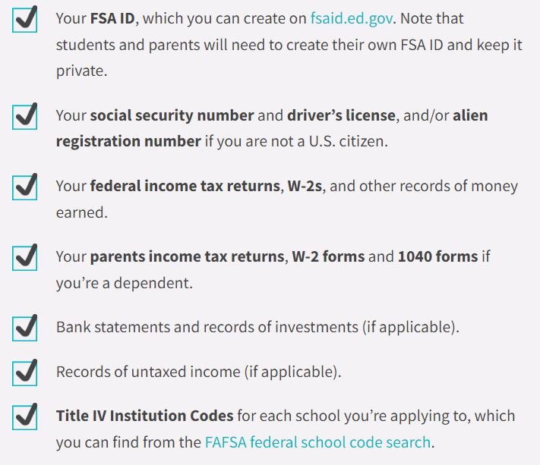
Information needed to get started
Notes:
FSA ID is a legal signature, do not share.
One for parent, one for student
Learn what to do if you live with only one parent other legal guardian or are independent
Income: 2021 TAX YEAR
Assets and Family Info : AS OF FILING DATE
If DRAMATICALLY DIFFERENT between 21/22: Fill it out and reach out directly to college to talk about an appeal / judgment

Slide 14
Additional Reference Slides

Slide 15
HOW DO I GET THERE?
HOW WILL I PAY FOR IT?
WHAT DO I WANT TO BE?
HOW MUCH WILL IT COST?
Explore Careers
Explore Paths
Program Costs
$$$
Naviance Career Cluster
ASVAB
Questionnaires
GATI
Guest Speaker Series
College/University Profiles
Technical College
Military
Gap Year
Straight to Work
Qualifying Criteria
Exam Prep
Money Matters
Tuition
Living Costs
Budgeting
Dual Enrollment
Scholarships
Financial Aid
529 Plans
Notes:
Explore Careers:
Favorite classes, big futures
Discuss industry hub cities
Explore Careers:
Post HS Options

